Slide 1
HM2 Tutorial
Cari & Ayush

Slide 2
Logistics
Due Date: Feb 17 @ 11:59PM
Grace Period: Feb 19 @ 11:59PM
Part 1
test_backward (test_conv.TestConv) (1/1)
test_forward (test_conv.TestConv) (1/1)
test_backward (test_linear.TestLinear) (0.5/0.5)
test_forward (test_linear.TestLinear) (0.5/0.5)
test_backward (test_maxpool.TestConv) (1/1)
test_forward (test_maxpool.TestConv) (1/1)
test_backward (test_relu.TestReLU) (0.5/0.5)
test_forward (test_relu.TestReLU) (0.5/0.5)
test_sgd (test_sgd.TestSGD) (1/1)
Part 2
test_accuracy (test_twolayer.TestTwoLayer) (1.5/1.5)
test_accuracy (test_vanilla_cnn.TestVanillaCNN) (1.5/1.5)
test_accuracy_easy (test_mymodel.TestMyModel) (1/1) – accuracy > 0.5
test_accuracy_medium (test_mymodel.TestMyModel) (1/1) – accuracy > 0.6
[Extra] test_accuracy_hard (test_mymodel.TestMyModel) (1/1) – accuracy > 0.7
[Extra] test_accuracy_very_hard (test_mymodel.TestMyModel) (1/1) – accuracy > 0.8

Slide 3
Part 1 - CNN from Scratch

Slide 4
Overview
CNN Forward pass
Assignment tips and tricks
CNN backpropagation

Slide 5
Part - 1: CNN Forward pass
Convolution: Use kernel to extract spatial information
Shallow layers (edges, corners) → Deep layers (shapes, objects)
Multiple filters for different information → stack the outputs
0 | 0 | 0 | 0
0 | 1 | 1 | 0
0 | 1 | 1 | 0
0 | 0 | 0 | 0
1 | 0 | -1
2 | 0 | -2
1 | 0 | -1
-1 | 1
-1 | 1
→
Convolved feature
Image
Image
Kernel
Notes:
Kernel extracts spatial information from an image, from low-level details such as edges and corners in the first few layers to high level details such as shapes deeper into the network. Different filters provide different information about an image, and we use multiple filters, each giving us a 2 dimensional convolved feature which we stack and output. In designing the CNN, some hyperparameters include number of filters used, height and width of the filters and the stride. Stride would be the size of the step taken. If you stride by one you move by one pixel… If you stride by 2… Smaller kernels and stride result in a larger convolved feature map, hence the information extracted is lower level and more information is preserved. More kernels increases the variety of information learned about the image, have increases the depth of the output. Padding help preserve the height and width of the convolved feature maps, preserving information on the edges.

Slide 6
Part - 1: CNN Forward pass
Convolution Example: Extracting vertical edges
0 | 0 | 0 | 0
0 | 1 | 1 | 0
0 | 1 | 1 | 0
0 | 0 | 0 | 0
 |  | 0 | 0
 |  | 1 | 0
0 | 1 | 1 | 0
0 | 0 | 0 | 0
0 | 0
0 | 1
1
Convolved feature
Image
-1 | 1
-1 | 1
Kernel

Slide 7
Part - 1: CNN Forward pass
Convolution Example: Extracting vertical edges
0 | 0 | 0 | 0
0 | 1 | 1 | 0
0 | 1 | 1 | 0
0 | 0 | 0 | 0
 |  | 0 | 0
 |  | 1 | 0
0 | 1 | 1 | 0
0 | 0 | 0 | 0
0 | 0
0 | 1
0 |  |  | 0
0 |  |  | 0
0 | 1 | 1 | 0
0 | 0 | 0 | 0
0 | 0
-1 | 1
1 | 0
Convolved feature
Image
-1 | 1
-1 | 1
Kernel

Slide 8
Part - 1: CNN Forward pass
Convolution Example: Extracting vertical edges
0 | 0 | 0 | 0
0 | 1 | 1 | 0
0 | 1 | 1 | 0
0 | 0 | 0 | 0
 |  | 0 | 0
 |  | 1 | 0
0 | 1 | 1 | 0
0 | 0 | 0 | 0
0 | 0
0 | 1
0 |  |  | 0
0 |  |  | 0
0 | 1 | 1 | 0
0 | 0 | 0 | 0
0 | 0
-1 | 1
0 | 0
0 | 1
0 | 1 | 1 | 0
0 | 0 | 0 | 0
0 | 0
-1 | 0
1 | 0 | -1
Convolved feature
Image
-1 | 1
-1 | 1
Kernel

Slide 9
Part - 1: CNN Forward pass
Convolution Example: Extracting vertical edges
0 | 0 | 0 | 0
0 | 1 | 1 | 0
0 | 1 | 1 | 0
0 | 0 | 0 | 0
 |  | 0 | 0
 |  | 1 | 0
0 | 1 | 1 | 0
0 | 0 | 0 | 0
0 | 0
0 | 1
0 |  |  | 0
0 |  |  | 0
0 | 1 | 1 | 0
0 | 0 | 0 | 0
0 | 0
-1 | 1
0 | 0
0 | 1
0 | 1 | 1 | 0
0 | 0 | 0 | 0
0 | 0
-1 | 0
1 | 0 | -1
2
Convolved feature
Image
0 | 0 | 0 | 0
 |  | 1 | 0
 |  | 1 | 0
0 | 0 | 0 | 0
-1 | 1
-1 | 1
0 | 1
0 | 1
Kernel

Slide 10
Part - 1: CNN Forward pass
Convolution Example: Extracting vertical edges
0 | 0 | 0 | 0
0 | 1 | 1 | 0
0 | 1 | 1 | 0
0 | 0 | 0 | 0
 |  | 0 | 0
 |  | 1 | 0
0 | 1 | 1 | 0
0 | 0 | 0 | 0
0 | 0
0 | 1
0 |  |  | 0
0 |  |  | 0
0 | 1 | 1 | 0
0 | 0 | 0 | 0
0 | 0
-1 | 1
0 | 0
0 | 1
0 | 1 | 1 | 0
0 | 0 | 0 | 0
0 | 0
-1 | 0
1 | 0 | -1
2 | 0
Convolved feature
Image
0 | 0 | 0 | 0
 |  | 1 | 0
 |  | 1 | 0
0 | 0 | 0 | 0
0 | 0 | 0 | 0
0 |  |  | 0
0 |  |  | 0
0 | 0 | 0 | 0
-1 | 1
-1 | 1
0 | 1
0 | 1
-1 | 1
-1 | 1
Kernel

Slide 11
Part - 1: CNN Forward pass
Convolution Example: Extracting vertical edges
0 | 0 | 0 | 0
0 | 1 | 1 | 0
0 | 1 | 1 | 0
0 | 0 | 0 | 0
 |  | 0 | 0
 |  | 1 | 0
0 | 1 | 1 | 0
0 | 0 | 0 | 0
0 | 0
0 | 1
0 |  |  | 0
0 |  |  | 0
0 | 1 | 1 | 0
0 | 0 | 0 | 0
0 | 0
-1 | 1
0 | 0
0 | 1
0 | 1 | 1 | 0
0 | 0 | 0 | 0
0 | 0
-1 | 0
1 | 0 | -1
2 | 0 | -2
1 | 0 | -1
Convolved feature
Image
0 | 0 | 0 | 0
 |  | 1 | 0
 |  | 1 | 0
0 | 0 | 0 | 0
0 | 0 | 0 | 0
0 |  |  | 0
0 |  |  | 0
0 | 0 | 0 | 0
-1 | 1
-1 | 1
0 | 1
0 | 1
-1 | 1
-1 | 1
…
1 | 0 | -1
2 | 0 | -2
1 | 0 | -1
Kernel
Notes:
As you can see with this vertical edge filter, a positive value tells us there is an edge to the right of the image patch, negative value tells us there is a edge to the left of the image patch, 0 indicates no vertical edge in the image patch.

Slide 12
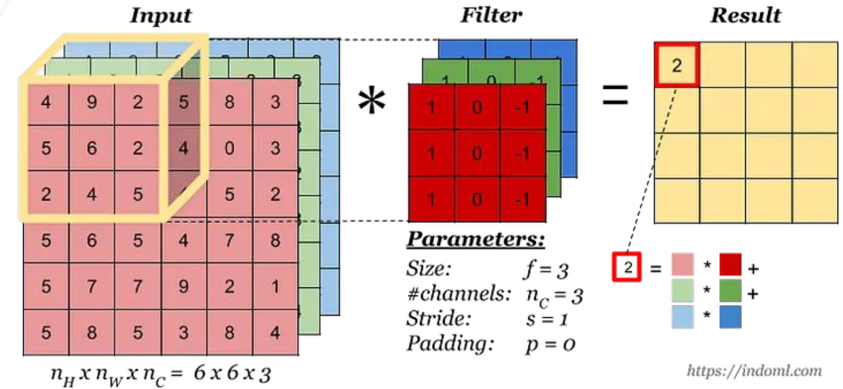
Part - 1: CNN Forward pass
Convolution:
Notes:
Images come in colour, which is represented by 3 channels, the red green and blue channels. Here, the kernel would get the value for each patch on each channel then sum them up across the channels to get the final value for that patch on the resultant convolved feature.

Slide 13
Part - 1: CNN From Scratch (For Assignment)
Convolution:
Calculate final size of output
Can use loops to iterate over batch, output_channels, row and column
Use np.pad, np.dot
Notes:
First step of the assignment is to calculate the output height and width which these equations give you. Then, you may use a for loop over the batch, output_channels (which represent the number of kernels), row and column Np.pad adds a padding around the edges of the image to help preserve the shape of the convolved feature map and information near the edges.
np.dot gives element wise multiplication and sum. However, you may optimize the implementation of this.

Slide 14
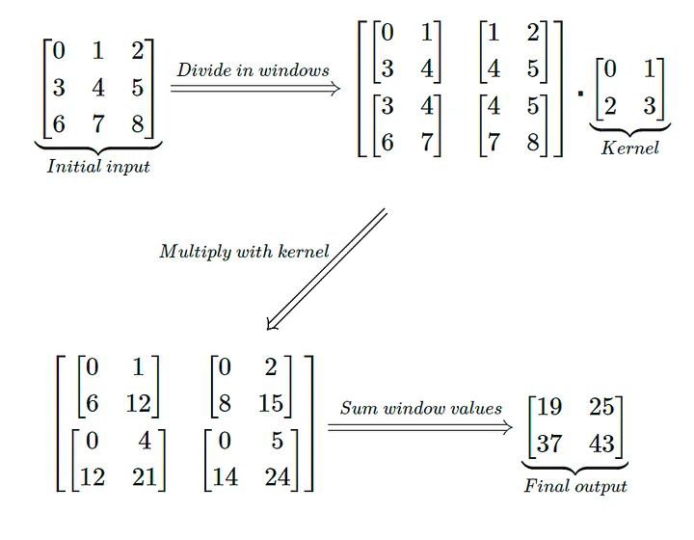
Part - 1: CNN From Scratch (For Assignment)
np.lib.stride_tricks.as_strided
Vectorization Tricks:
new_shape = (out_height, out_width, kernel_height, kernel_width)
new_strides = (row_strides x layer_strides, column_strides x layer_strides)
windowed_input = np.lib.stride_stricks.as_strided(input, new_shape, new_strides)
Notes:
Unlike the naive for loop implementation that creates a new array in the memory for each window, as_strided function creates a view of the input that looks like this. Where each cell of the matrix contains the window image patch for that cell in the final convolved feature map. You may then perform element-wise multiplication of the kernel on all the windows and sum each window to obtain the final output.
as_strided does not copy the data but creates a new view of the original array with different strides (the steps used to move through the array). This reduces memory consumption, as you're just "reinterpreting" the existing data rather than creating new arrays for each window, It also reduces time taken as you can access all patches needed in one go, reducing loop overheads and using numpy’s optimized.internal operations

Slide 15
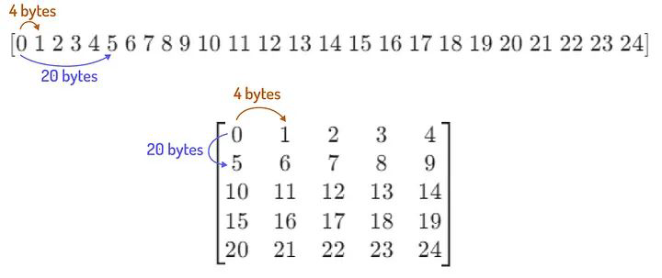
Part - 1: CNN From Scratch (For Assignment)
Vectorization Tricks:
new_shape = (out_height, out_width, kernel_height, kernel_width)
new_strides = (row_strides x layer_strides, column_strides x layer_strides)
windowed_input = np.lib.stride_stricks.as_strided(input, new_shape, new_strides)
Notes:
As_strided function requires the input image, new_shape and new_strides as input. The new_shape would be the shape of the output where out height is the number of rows in the full matrix, out_width the number of columns here and here, kernel_size the height and width of the kernel which would match the dimensions of each window in each cell.
New_strides consists of 2 values represented here. In the memory, our image input is stored as a flattened array as shown.
Row_stride would be the distance the next pixel in the row. As the next pixel in the row is situated to the immediate right, you just need to traverse one pixel distance, which is 4 bytes in this example.
Column_stride is the distance to the next pixel in the column. In the flattened array, you would have to go past all the elements in the first row to reach the next value in the column. As there are 5 pixels in each row, the column stride would be 5 x 4bytes.

Slide 16
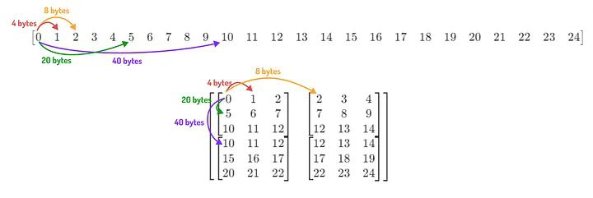
Part - 1: CNN From Scratch (For Assignment)
Vectorization Tricks:
new_shape = (out_height, out_width, kernel_height, kernel_width)
new_strides = (row_strides x layer_strides, column_strides x layer_strides)
windowed_input = np.lib.stride_stricks.as_strided(input, new_shape, new_strides)
layer_stride = 2
Notes:
Assume a layer stride of 2, our as_strided view would look like this

Slide 17
Part - 1: CNN From Scratch (For Assignment)
Vectorization Tricks:
new_shape = (out_height, out_width, kernel_height, kernel_width)
new_strides = (row_strides x layer_strides, column_strides x layer_strides)
windowed_input = np.lib.stride_stricks.as_strided(input, new_shape, new_strides)
Notes:
To access the next window in the row, we would then have to take row_strides x layer_stride, in this case 4bytes x 2 to get 8 bytes.
To access the next window in the column, we similarly multiply the column_stride with the layer_stride, in this case 20bytes x 2 to get 40 bytes
Putting all together, your new_strides would be as follows, the bytes distance to get to the next window in the row, the bytes

Slide 18
Part - 1: CNN From Scratch (For Assignment)
np.lib.stride_tricks.as_strided
Vectorization Tricks:
result = (A[:, None] * B).sum(axis=1)
OR
result = np.einsum('i,ij->i', A, B)
Notes:
Unlike the naive for loop implementation that creates a new array in the memory for each window, as_strided function creates a view of the input that looks like this. Where each cell of the matrix contains the window image patch for that cell in the final convolved feature map. You may then perform element-wise multiplication of the kernel on all the windows and sum each window to obtain the final output.
as_strided does not copy the data but creates a new view of the original array with different strides (the steps used to move through the array). This reduces memory consumption, as you're just "reinterpreting" the existing data rather than creating new arrays for each window, It also reduces time taken as you can access all patches needed in one go, reducing loop overheads and using numpy’s optimized.internal operations

Slide 19
Part - 1: CNN From Scratch (For Assignment)
Vectorization Tricks:
A = np.array([0, 1, 2]) # (3,)
B = np.array([[ 0, 1, 2, 3],
[ 4, 5, 6, 7],
[ 8, 9, 10, 11]]) # (3,4)
A[:, None] = [[0],
[1],
[2]]
result = (A[:, None] * B).sum(axis=1)
result = np.einsum('i,ij->i', A, B)
Convolution
np.einsum('TBD', windowed_input, weights)
https://stackoverflow.com/questions/26089893/understanding-numpys-einsum
Notes:
A[:, none] appends a dimension to the end, resulting in something like this. Broadcasting happens, where each element is broadcasted and multiplied with every other element in the row of B. Lastly, you sum across the row to get the final output.
Einsum does this more concisely and uses numpy’s internal operations to make this more efficient. So in the subscript string here, i represent the shape of A, ij are the shape of B and einsum does element-wise multiplication and sums across the row to get a output with shape i.
Given the windowed_input from earlier and weights, determine the subscript string for your task in the assignment!

Slide 20
Note on Broadcasting (For Assignment)
# Example random array of shape (a, b, c)
A = np.random.rand(a, b, c)
B = np.random.rand(b,) # Array of shape (b,)
# B[:, None] converts B to shape (b, 1)
# A + B[:, None] or A + B[:, np.newaxis]
result = A + B[:, None] # Since it is added to (a, b, c) so the
resulting shape of B for broadcasting is
(1, b, 1)
Notes:
Let’s say you want to add B to the bth dimension of array A. Use None to introduce a dimension at the back to match the cth dimension, then for the dimensions to the left of b, broadcasting automatically adds a dimension with size 1 to match the dimension.

Slide 21
Unravel Index (For Assignment)
The np.unravel_index function helps to translate a 1D flat index back into a multi-dimensional coordinate based on the array's shape. This is useful when working with flattened arrays but needing to refer back to the original multidimensional array structure.
arr_2d = np.array([[0, 1, 2],
[3, 4, 5],
[6, 7, 8]])
(0,0) (0,1) (0,2)
(1,0) (1,1) (1,2)
(2,0) (2,1) (2,2)
Indexes
flat_index = 5 # Corresponds to the index of the flattened array (np.ravel(arr_2d))
multi_index = np.unravel_index(flat_index, arr_2d.shape) # takes a flat index and the shape of the array
to return the multi-dimensional index.
print(multi_index) # Returns (1,2)
Notes:
Flattens array, index the array, return the row, column multi-index

Slide 22
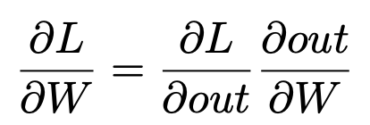
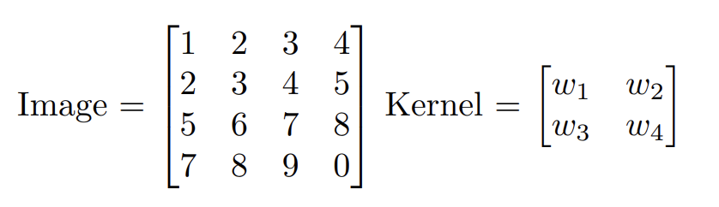
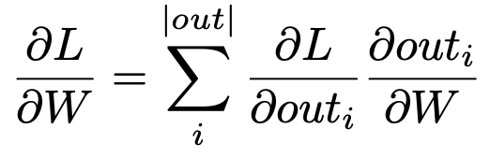
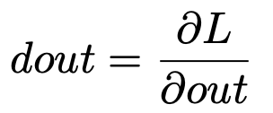

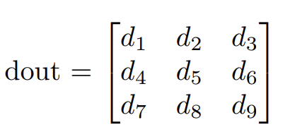
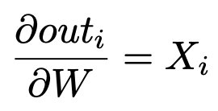
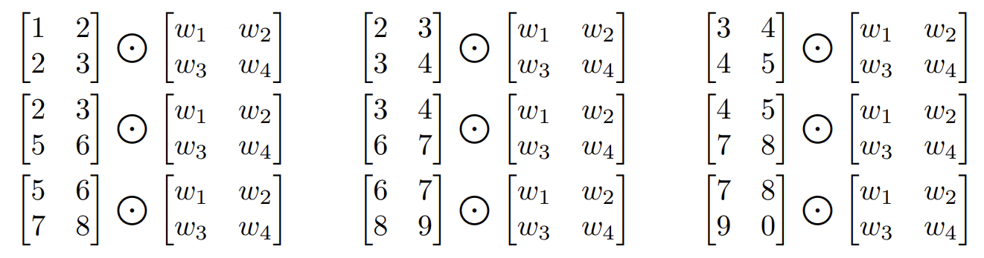
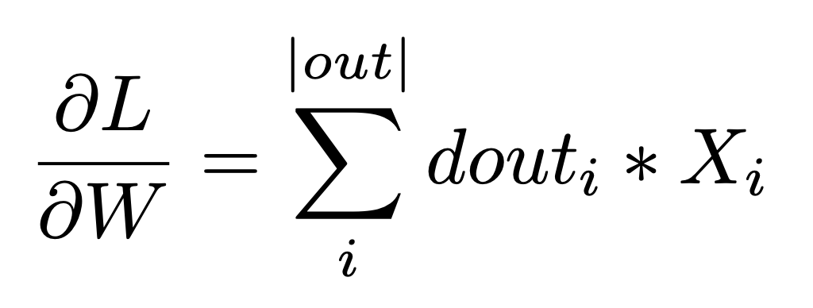
CNN Backpropagation
Recall Forward pass:
[
]
out =
(3x3 matrix)

Slide 23
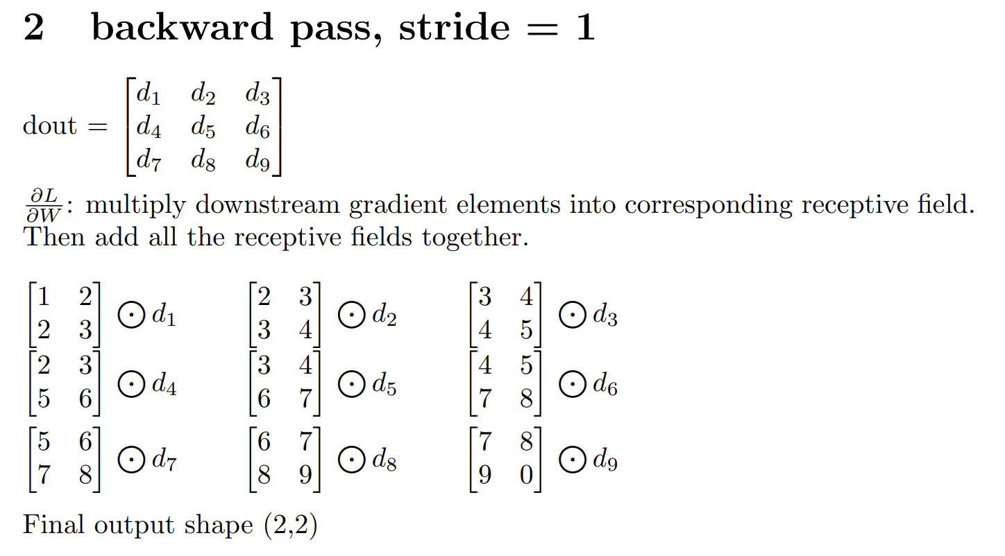
CNN Backpropagation

Slide 24

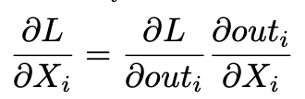
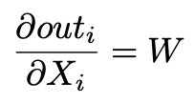
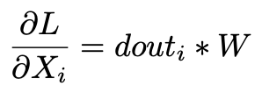
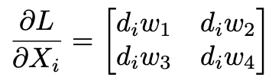
CNN Backpropagation
Recall Forward pass:
[
]
out =
(3x3 matrix)

Slide 25
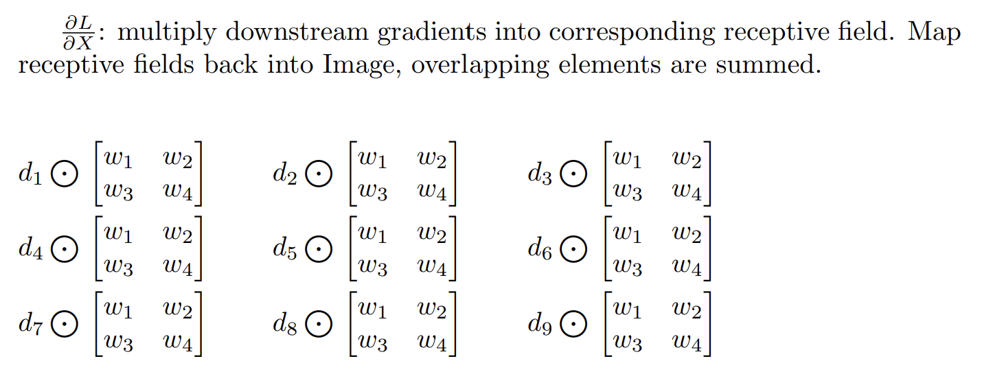
CNN Backpropagation

Slide 26
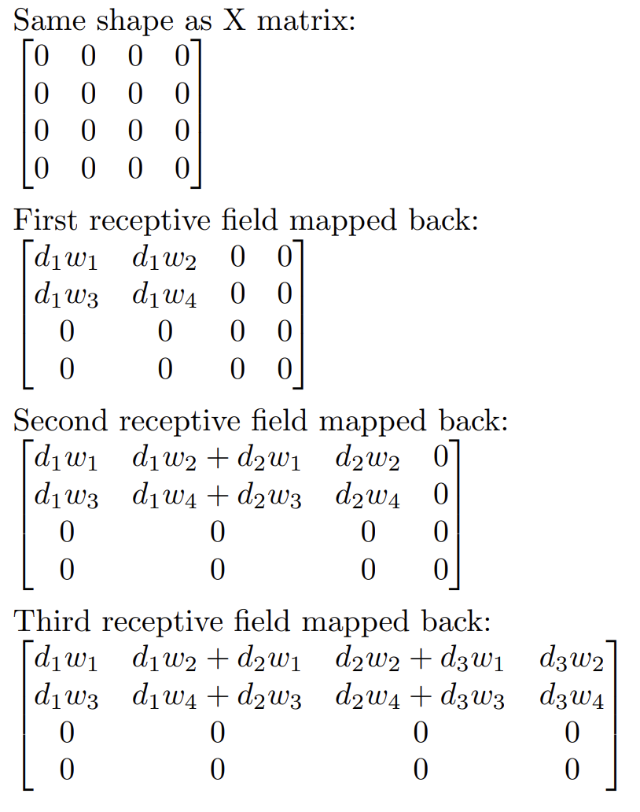
CNN Backpropagation

Slide 27
Part 2 - Pytorch

Slide 28
Part - 2: PyTorch
main.py
Complete the body of training loop
Set model to training mode and reset the gradients of the model
Forward data batch to the model
Compute batch loss
Compute gradients and update model parameters
Complete the body of evaluation loop
Set model to evaluation mode
Disable gradient computation with torch.no_grad()
The torch.no_grad() context disables gradient tracking. In evaluation mode, gradients are not needed because no parameter updates will be made
Forward data batch to the model
Compute batch loss

Slide 29
Part - 2: PyTorch
In PyTorch, you typically don't need to manually implement the backward function for most standard neural network layers. The main reason for this is that PyTorch uses automatic differentiation.
models/twolayer.py
Define the Network Architecture (__init__ method)
Build the model with two fully connected layers and a sigmoid activation function in between the two layers
Implement the Forward Pass (forward method)
Input to hidden layer, Sigmoid activation, Hidden layer to output, Softmax for output

Slide 30
Part - 2: PyTorch
models/cnn.py
Define the Network Architecture (__init__ method)
Build the model with a convolution layer, a ReLU activation, a max-pooling layer, followed by a fully connected layer for classification
Convolutional layer: 7x7 kernel, stride 1, padding 0
ReLU activation function
Max pooling layer with a 2x2 kernel and stride of 2
FC layer to produce final class logits
Input images are 32x32 (CIFAR-10 size), after applying conv and max pooling, we need to calculate the size of the flattened feature vector before the FC layer
Implement the Forward Pass (forward method)
Apply convolution, Apply ReLU activation, Apply Max Pooling, Flatten the tensor, Apply the FC layer

Slide 31
Part - 2: PyTorch
models/my_model.py
Build your own model
OK to borrow some insights from existing well-known networks and build the model from scratch
NOT OK to use any sort of pre-trained weights
Free to tune any hyper-parameters to obtain better accuracy
Final accuracy must be above 0.5 to receive at least partial credit.
Make sure the checkpoints of each model are saved into ./checkpoints

Slide 32
Q&A

